Slide 1
SUPPORT VECTOR MACHINE (SVM) CLASSIFIER
Sourav Karmakar
souravkarmakar29@gmail.com

Slide 2


SUPPORT VECTORS: INTUITION
In a binary classification problem we usually want to find a Line (Usually a hyperplane) that separates the two classes of the points.
To choose a “good” line:
We have to optimize some objective function (For ex. In Logistic regression we minimized the cross-entropy loss function)
Usually the objective function depends on all the points.
Class-1
Class-2
There can be many such lines. Hence, finding a “good” line is a difficult task. Moreover, changing the position of the training points can affect the decision plane.
Primarily we want least number of misclassification of the test points. Now consider a decision plane. Which points are more likely to be misclassified?

Slide 3
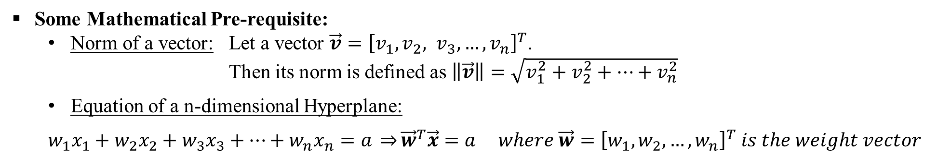
SUPPORT VECTORS: INTUITION
Answer: The test points which are closer to the decision boundary are more likely to be misclassified.
Hence, while designing the classifier, we need to give more emphasis on the training points which are closer to the border.
Class-1
The training points closer to the border which are most crucial to design the classifier are known as Support Vectors.
Class-2

Slide 4

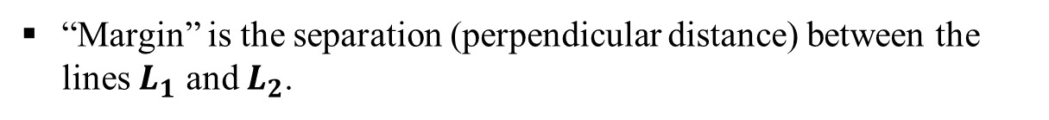




SUPPORT VECTOR MACHINE
Support Vectors
Identify support vectors, the training data points those are closer to the boundary and act as “support”.
Class-1
Class-2
Margin
Our objective is to maximize the margin. Hence, Support Vector Machine is also called the maximum margin classifier.

Slide 5

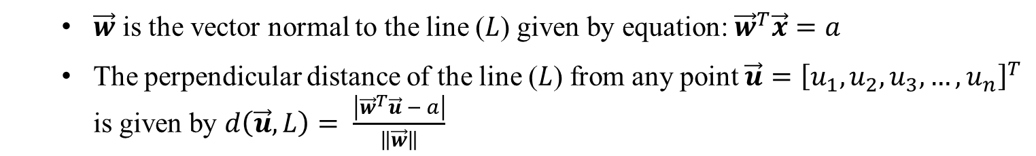

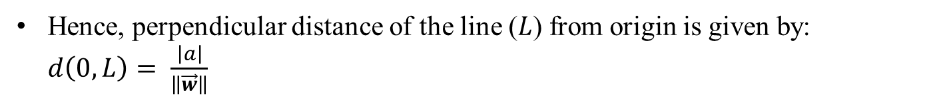






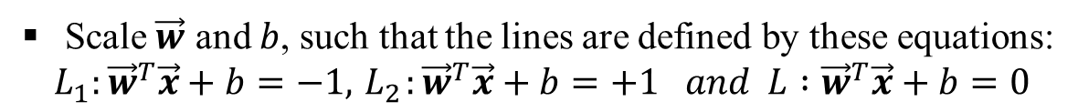



SUPPORT VECTOR MACHINE
Class-1
Class-2

Slide 6

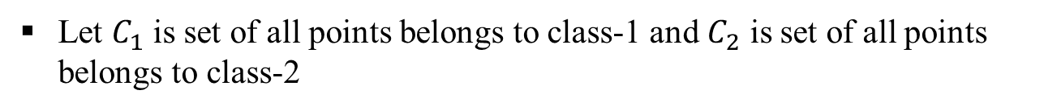

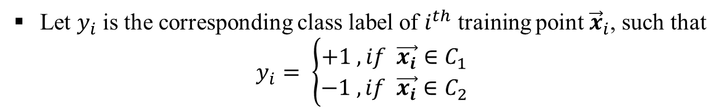
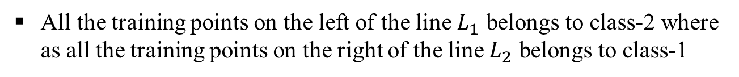



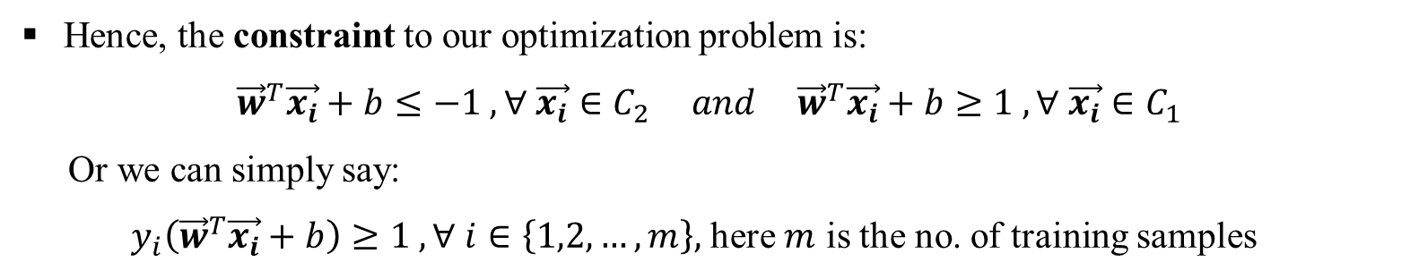
SUPPORT VECTOR MACHINE
Class-1
Class-2

Slide 7
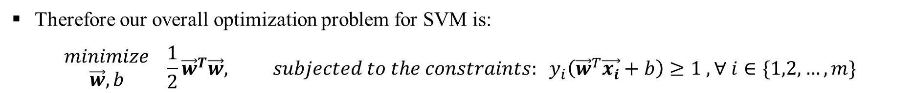
SUPPORT VECTOR MACHINE
Note that this is for binary classification. For multiclass classification we can again use decomposition techniques like One-vs-All (OVA) or One-vs-Rest (OVR).
This is called Hard Margin Support Vector Machine (SVM) Classifier, as opposed to Soft Margin SVM Classifier, which we shall introduce shortly.

Slide 8



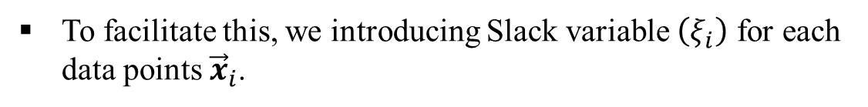
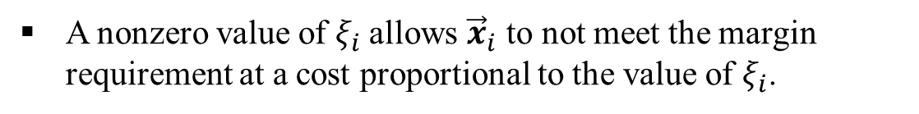
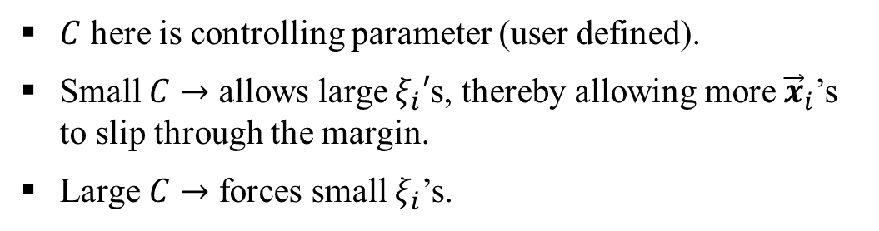
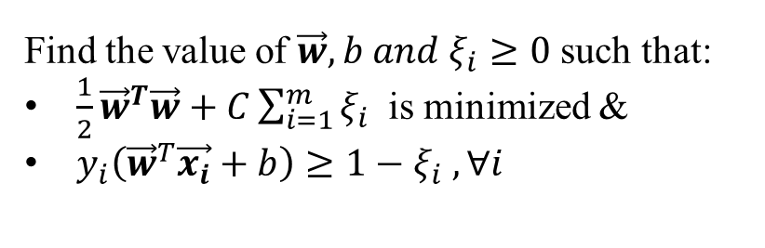
SOFT MARGIN SVM
Soft Margin SVM is suitable for the non-ideal cases where the data points are not completely separable.
Some data points are in the wrong side of the margin. The standard approach is to allow the decision margin to make a few mistakes.
Class-1
Class-2
We then pay a cost for each misclassified example, which depends on how far it is from meeting the margin requirement.
Hence, our modified objective is:

Slide 9

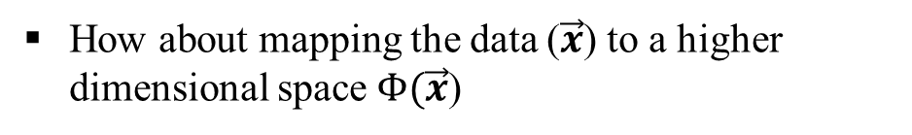



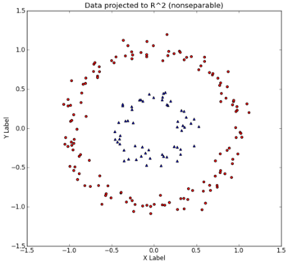
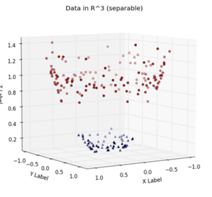
NON-LINEAR SVM
The SVM we have learned so far works great for linearly separable datasets. Hence, this is also called linear SVM.
But what we are going to do when the dataset is too hard?
0
The dataset may become linearly separable in higher dimensional space and can be classified using linear SVM.
General idea: the original feature space can always be mapped to some higher-dimensional feature space where the training set is almost linearly separable.

Slide 10
NON-LINEAR SVM: KERNEL TRICK
Kernel function transforms the datapoints from lower dimensional space to higher dimensional space.
There are different kinds of kernels. Few of them are mentioned below:
There are different other kernels. User can define a novel kernel based on the requirement. However the above mentioned kernels are suitable for almost all kinds of problems and hence mostly used.

Slide 11
SVM: Merits & Demerits
Merits:
SVM is a strong classifier which out performs other classifiers in many classification problems.
Mathematically sound : A nice optimization problem which is guaranteed to converge to a single global optima.
Can work on very high dimensional feature space as complexity doesn’t depend on the dimensionality of the feature space.
Can work on non-linearly separable cases using suitable kernel function.
Demerits:
Tuning SVMs remains less intuitive: selecting a specific kernel function and parameters is usually done in a try-and-see manner.

Slide 12
Thank You

